Slide 1
The painting palettes of human ancestry
Daniel Falush, Dan Lawson,
Garrett Hellenthal, Simon Myers.
www.paintmychromosomes.com

Slide 2
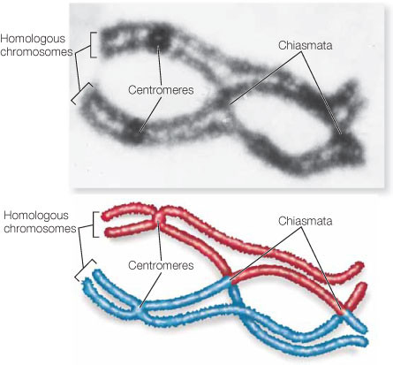
We want to “paint” DNA according to which ancestor it comes from
Father
Mother
Child
Crossover event breakpoint
(O’Connor 2008)

Slide 3
Recombination “mosaic” genomes
Positions of recombination crossover events

Slide 4
Recombination “mosaic” genomes

Slide 5
Recombination “mosaic” genomes

Slide 6
Chromosome “painting”
Ancient ancestors
We share segments of DNA today, inherited from shared ancestors living in the distant past.
Identifying these shared segments, and insights into the genetics of people from the UK, and worldwide human migrations

Slide 7
Chromosome painting in practice
(Lawson et al. 2012)
Painting panel
Focal
chromosome
6
2
1.0
3
0.5
palette
0.0

Slide 8
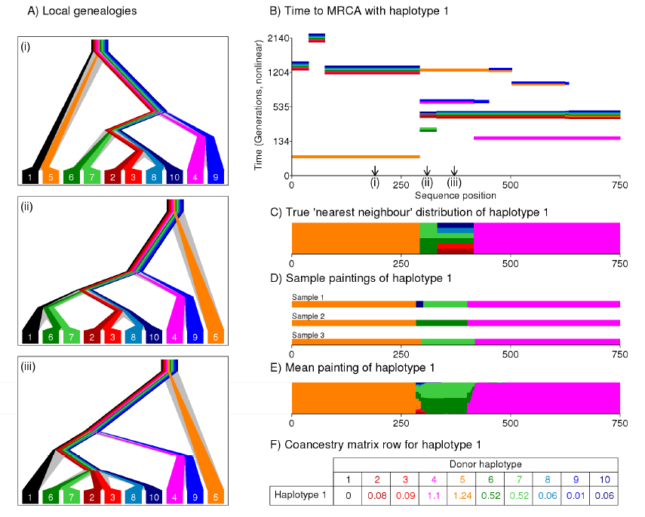

Slide 9
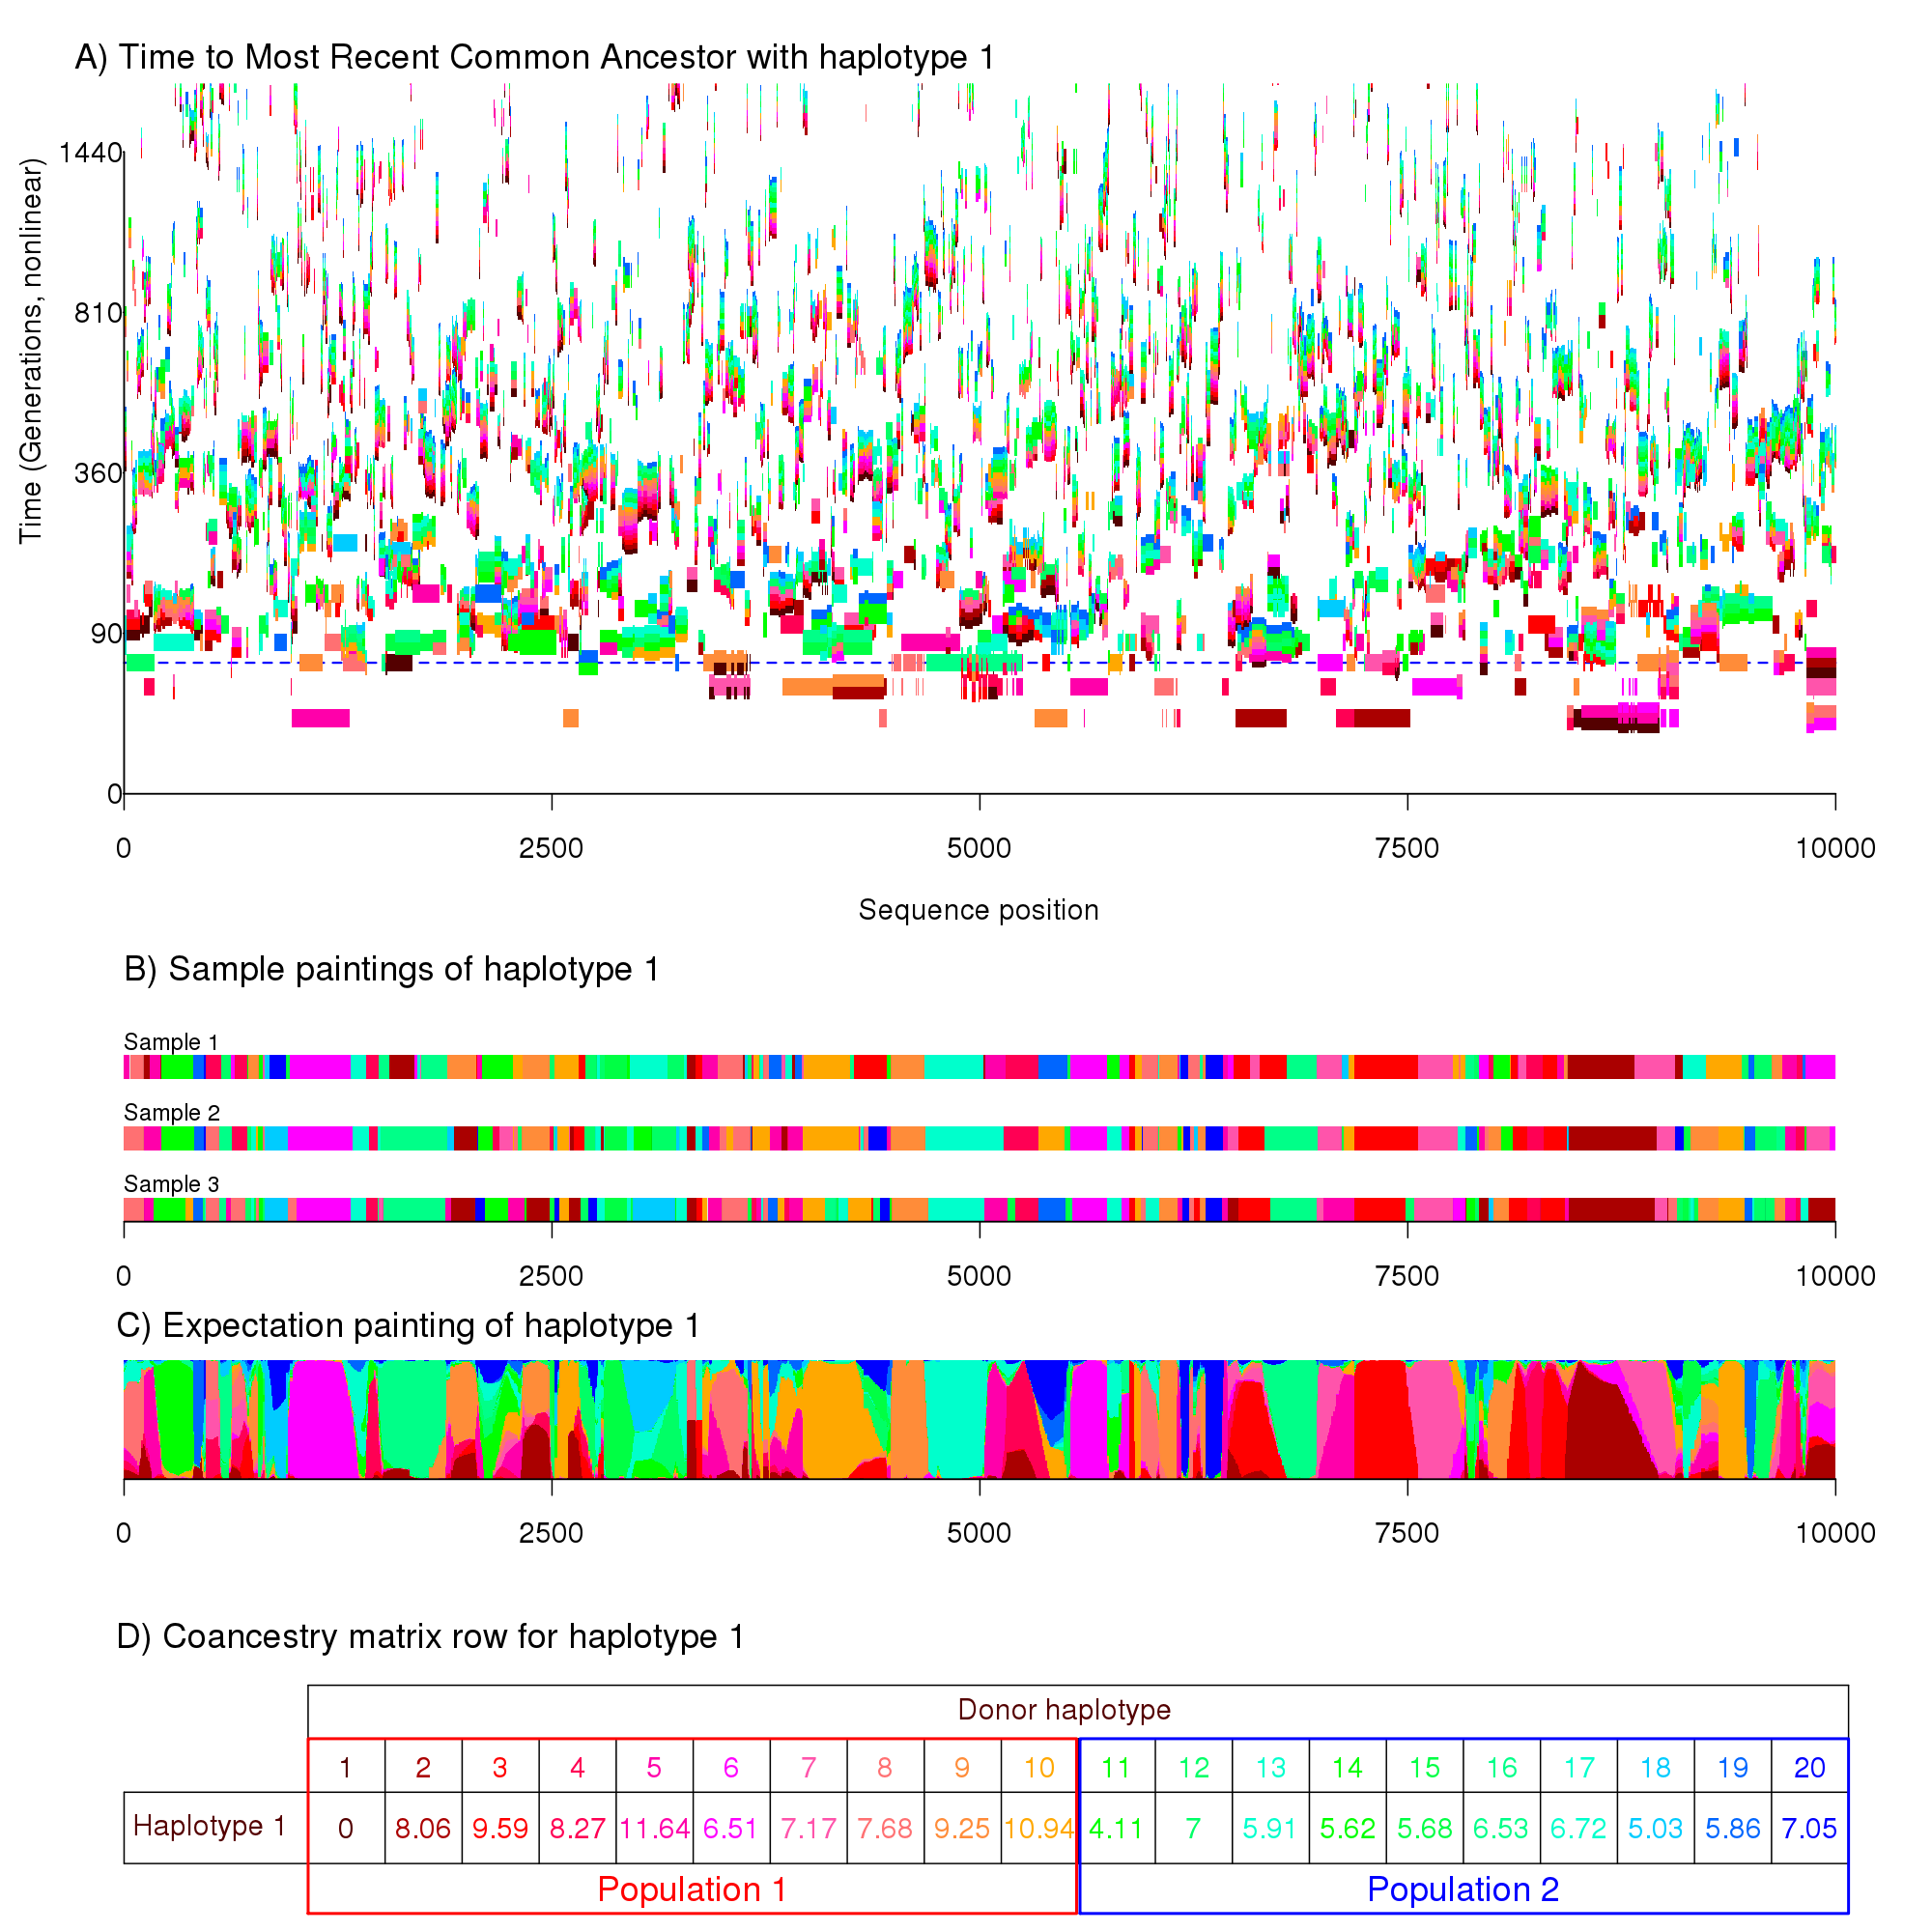

Slide 10
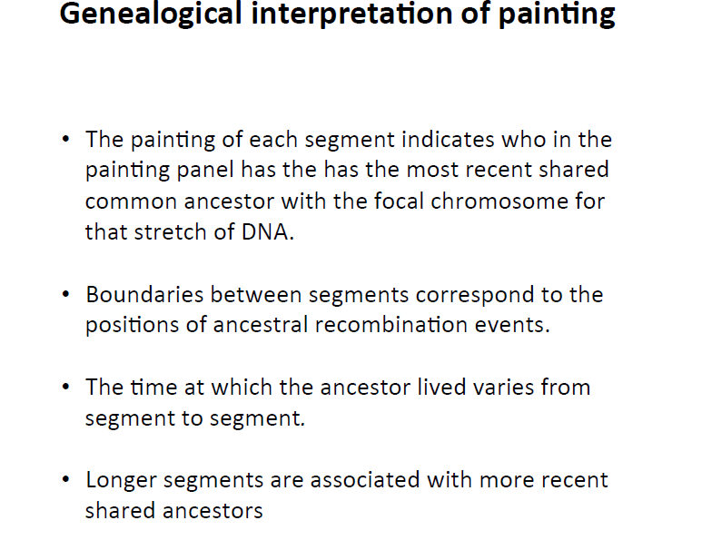

Slide 11
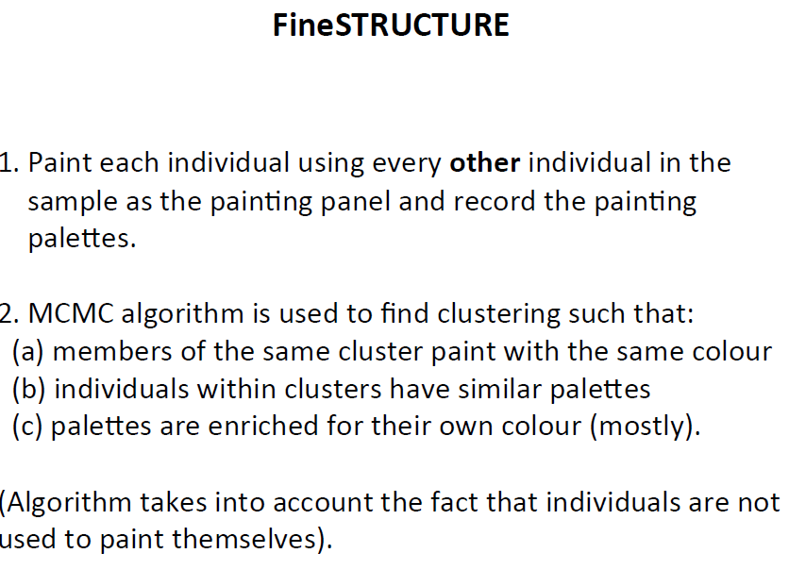

Slide 12
toy FineSTRUCTURE example

Slide 13
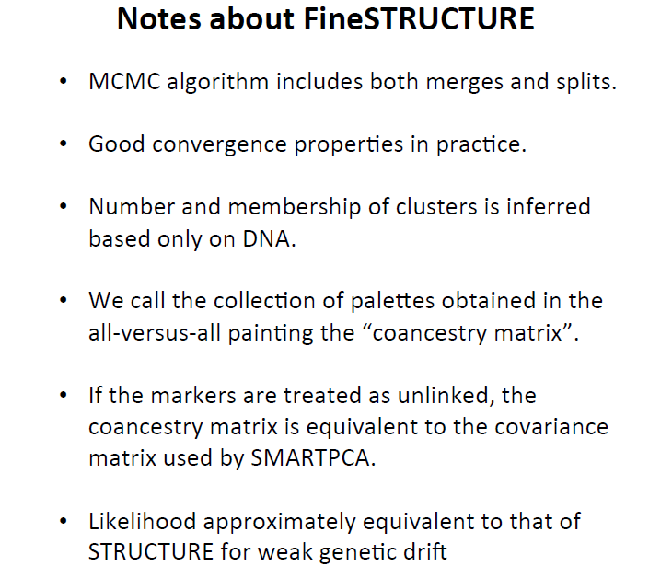

Slide 14
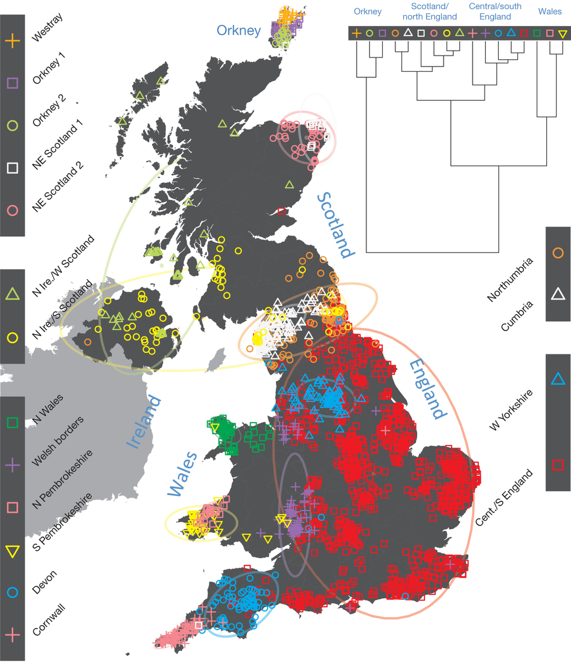
Application to Peopling of British Isles project
Sampled individuals had all four grandparents living within 50 miles of each other.
Genotyped using SNP chip. (500,000 markers)
54 distinct palettes inferred by fineSTRUCTURE
Build a tree: by successively joining groups with the most similar palettes.
CREDIT: Bruce Winney, Stephen Leslie,
Walter Bodmer, Peter Donnelly
Notes:
Lacks physical barriers to movement, under centralised Roman control, later Saxon control

Slide 15
British palettes
Devon
S Wales
Orkney
Orkney
S Wales
Cumbria
Westray
Cornwall
N Wales
Cheshire
SE England
Newcastle
NE Scotland
Forest of Dean
W Scotland+NI
NE Scotland
W Scotland+NI

Slide 16
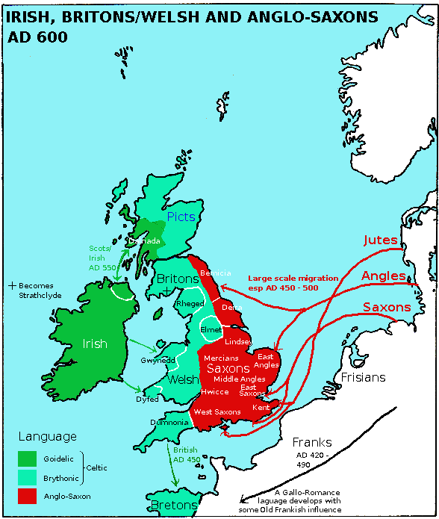
Clusters very strongly resemble ancient geopolitical groupings
Notes:
Also might reflect geography,

Slide 17
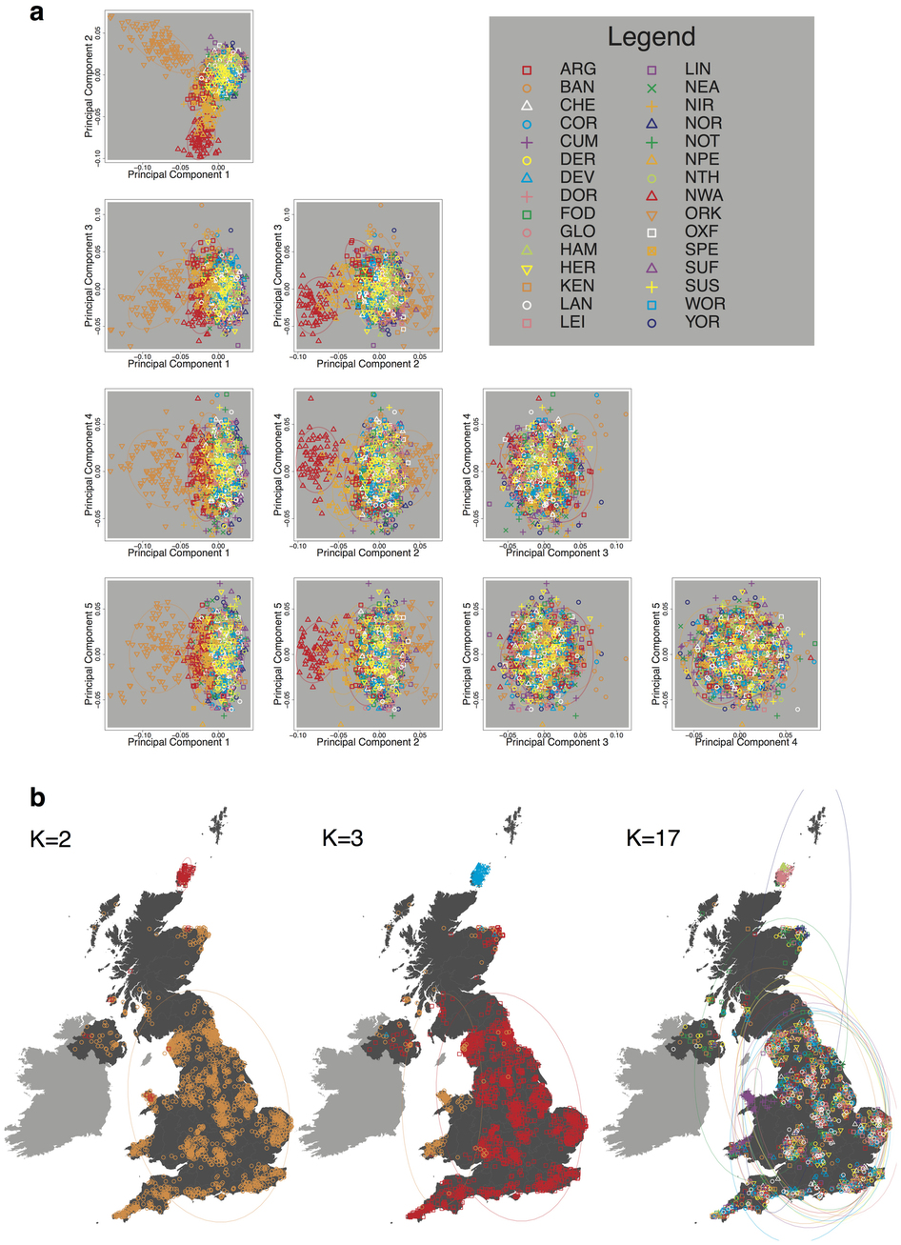
Traditional software (Admixture)

Slide 19
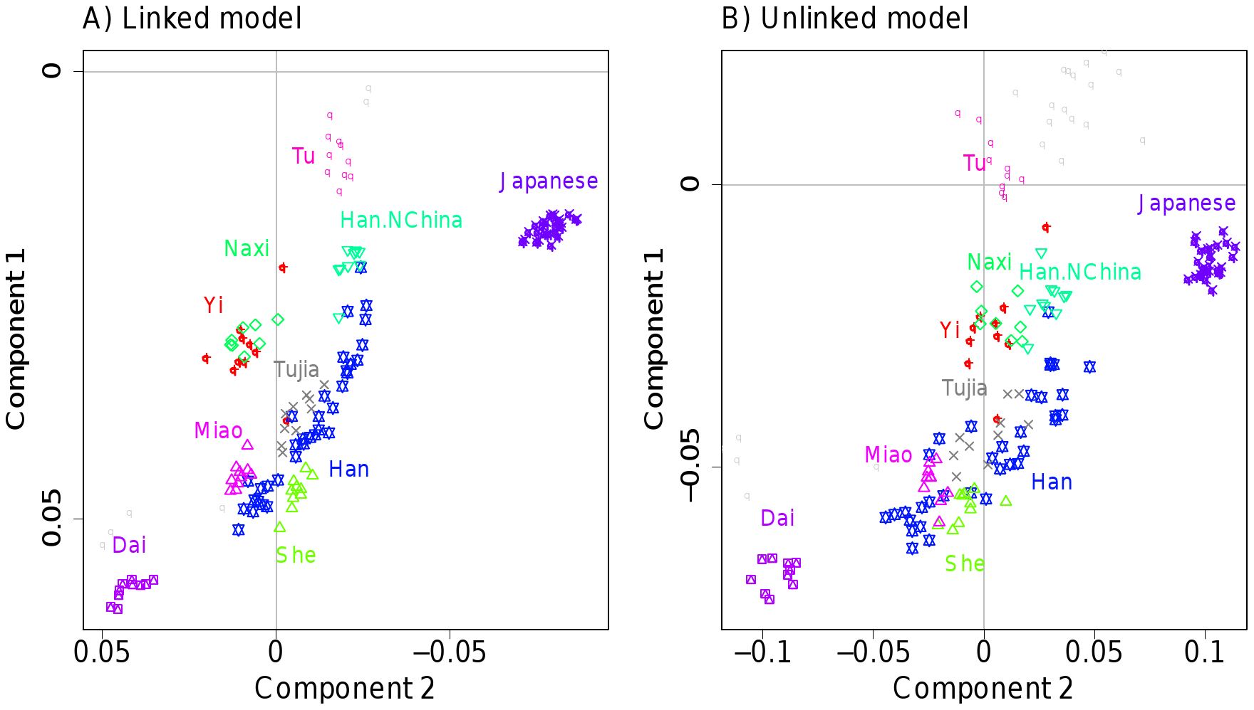

Slide 20
Continental European palettes
Hospital based sampling as controls for an association study with FineSTRUCTURE used to identify populations

Slide 21
British palettes
painted with a continental European panel
Devon
S Wales
Orkney
Orkney
S Wales
Westray
Cornwall
N Wales
Cheshire
Newcastle
SE England
Cumbria
NE Scotland
Forest of Dean
W Scotland+NI
NE Scotland
W Scotland+NI

Slide 22
Mixture modelling of an English palette based on
European palettes using Non-Negative Least Squares

Slide 26
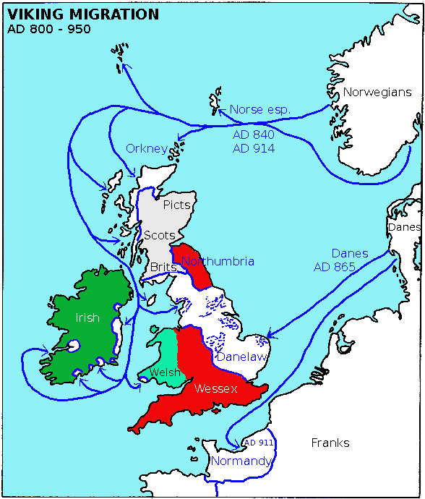
e
Danish Vikings colonisations
from v. similar region to previous Anglo-Saxons

Slide 27
CREDIT: Christian Capelli, George Busby

Slide 28
Worldwide palettes

Slide 29
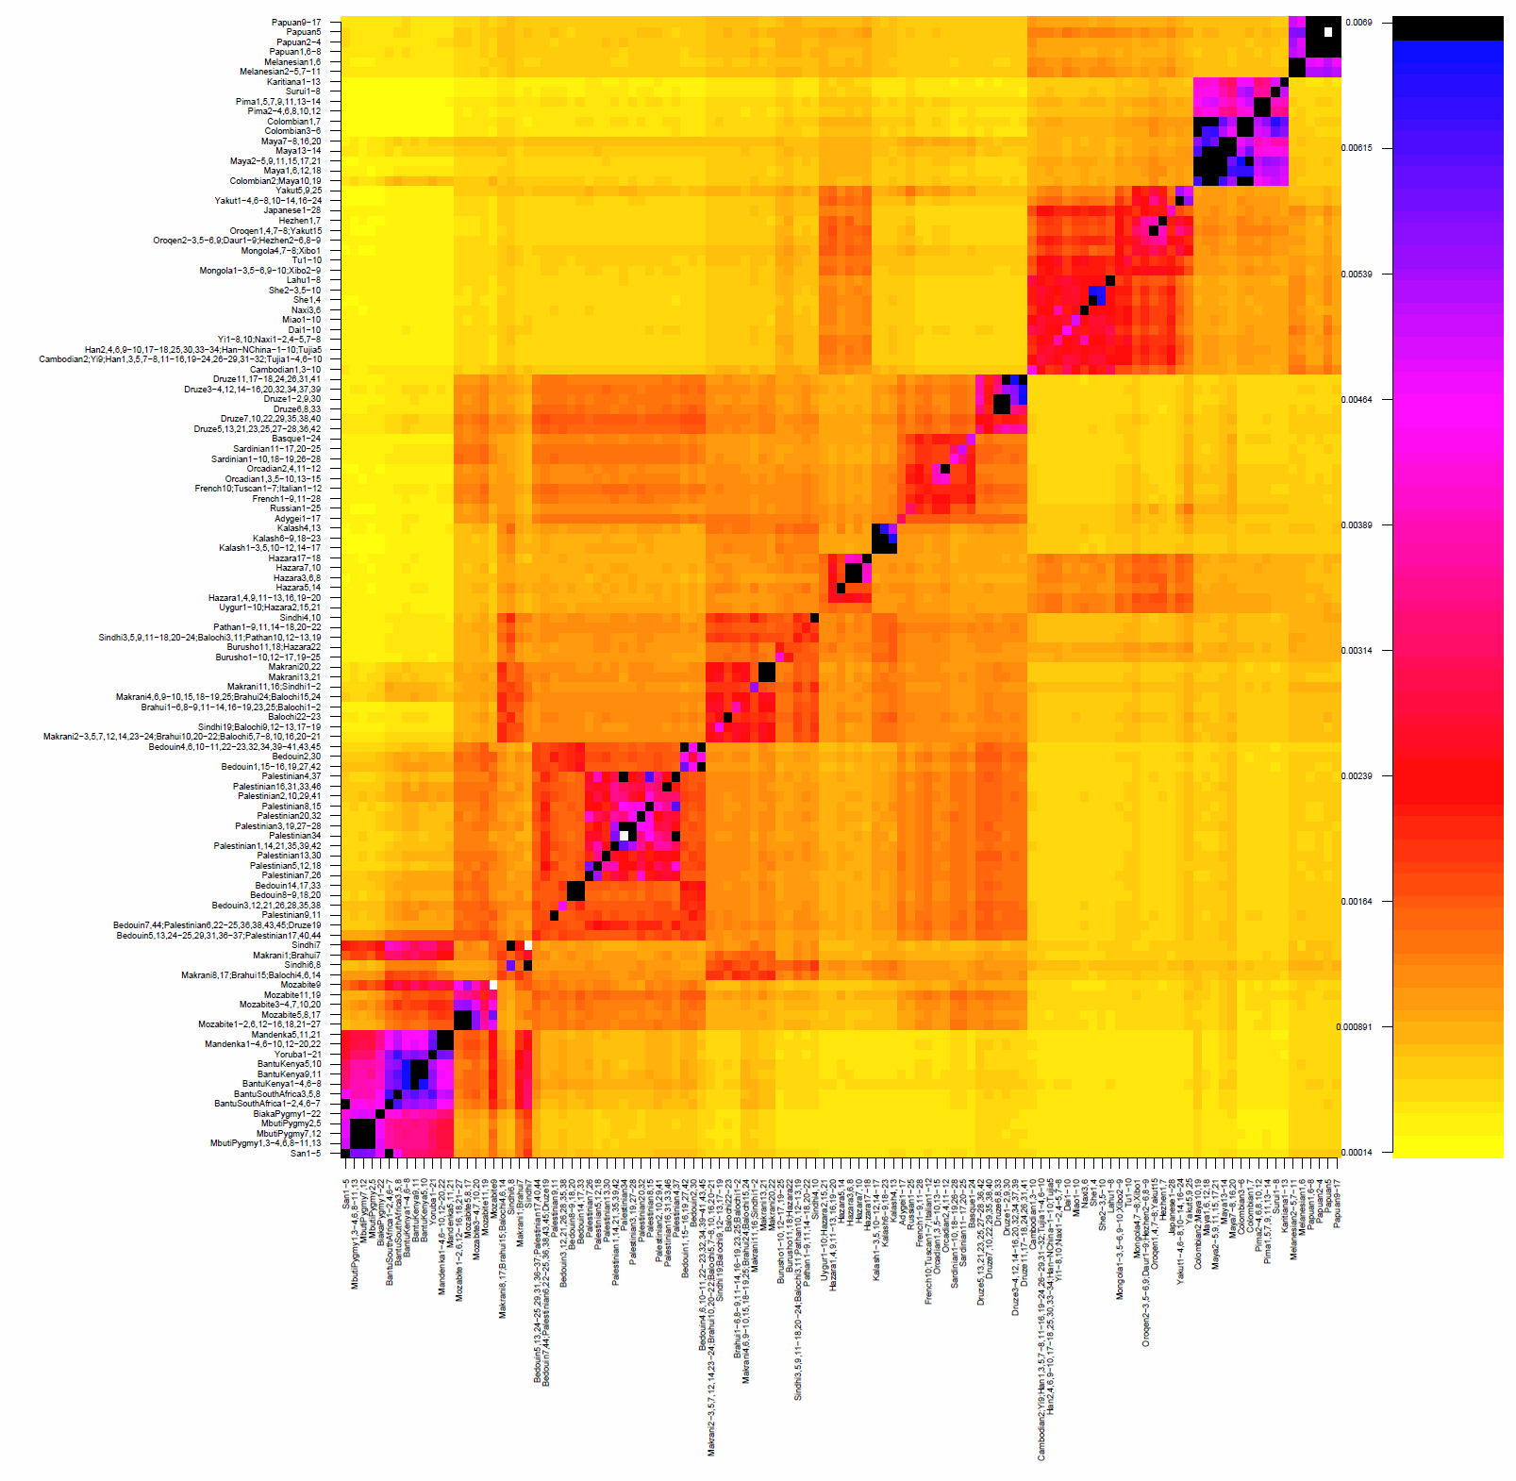
169 populations inferred in HGDP data

Slide 30
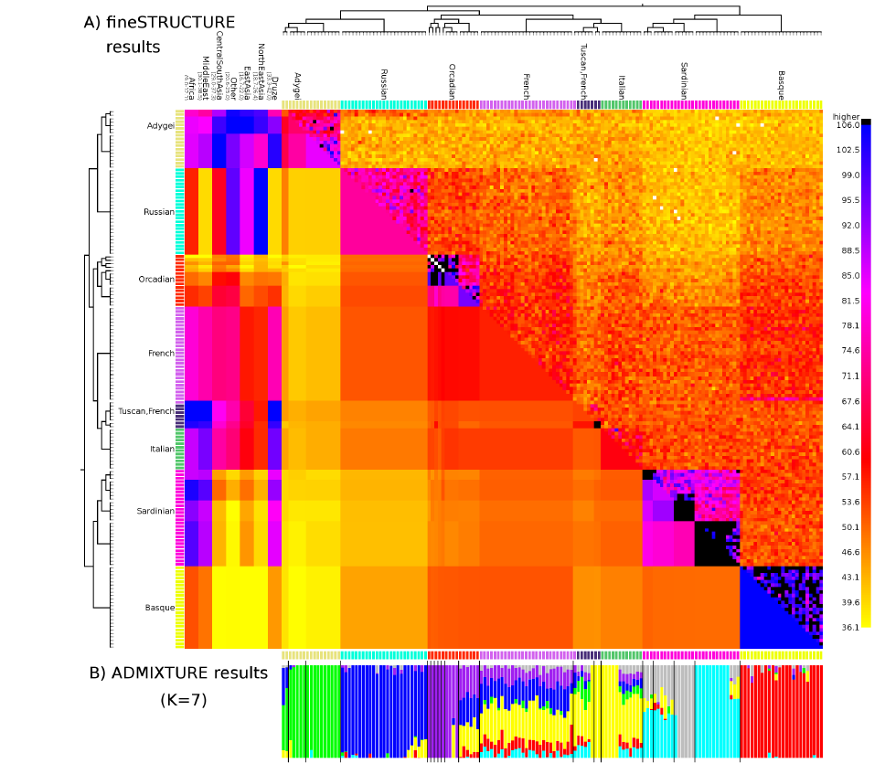
Adygei
Russian
Orcadian
French
Tuscan
Bergamo
Sardinian
Basque

Slide 31
HGDP Middle east

Slide 32
Half-matching based on coancestry matrix

Slide 33
Information on time since mixture given by spatial structure of ancestry along the chromosome

Slide 34
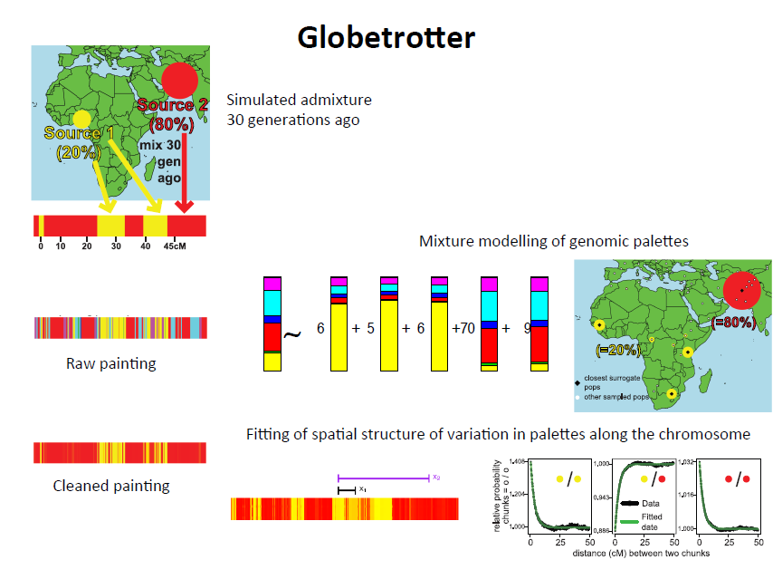

Slide 37
Can also identify complex events such as
multi-way admixture

Slide 40
Conclusions
Can use chromosome painting to
Distill ancestry information
Cluster based on genetic similarity
Visualise genetic drift
Identify mixtures
Date mixture events
Reconstruct history

Slide 41
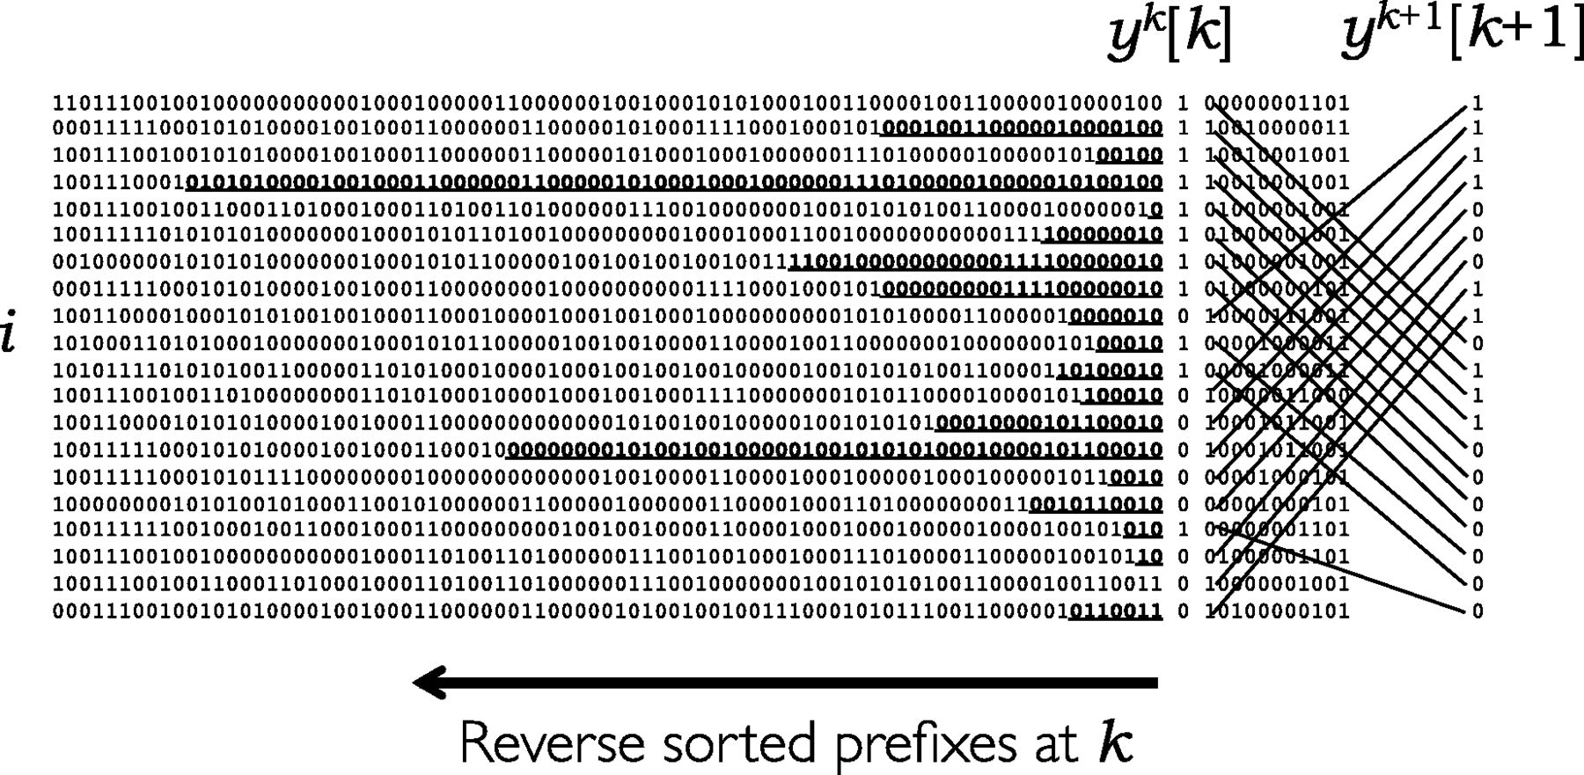

Positional Burrows Wheeler Transform
A set of haplotype sequences sorted in order of reversed prefixes at position k, showing the set of values at k isolated from those before and after, and on the right hand side how the order at position (k + 1) is derived from that at k as in Algorithm 1.
Richard Durbin Bioinformatics 2014;30:1266-1272
© The Author 2014. Published by Oxford University Press.
Notes:
A set of haplotype sequences sorted in order of reversed prefixes at position k, showing the set of values at k isolated from those before and after, and on the right hand side how the order at position (k + 1) is derived from that at k as in Algorithm 1. Maximal substrings shared with the preceding sequence ending at k are shown bold underlined; these start at position d_{k}[i] as calculated in Algorithm 2

Slide 42
